Slide 1
PProject Management Infgraphicsd
CP468 Project
Group 8
Here is where your presentation begins
Shane Riley - 170696320
Adam Joe - 170801790
Deepinder Sidhu- 170274550

Slide 2
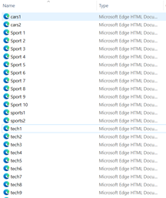
Document Collection
Phase 1
We first had to decide on the feature vectors we would use, our group decided to use the topics “Technology”, “Cars”, and “Sports” so to help decide on vectors we first created lists of words we thought had a very strong relevance to these topics.
We then collected 10 documents for each topic by searching for these terms online and choosing appropriate documents that featured many relevant words.
Retrieving an html copy of the website (ctrl+u)
Saving it to our files. (ctrl+s)

Slide 3
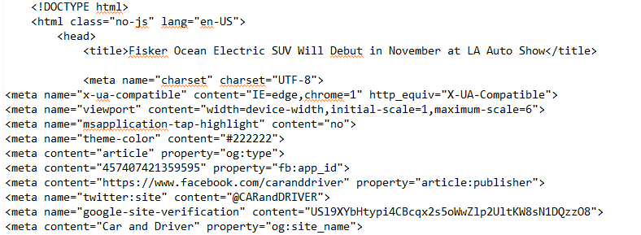
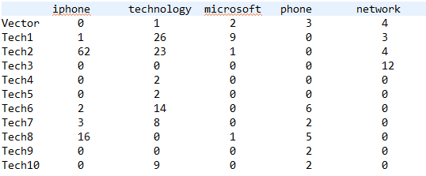
Web Crawler
Phase 2
Classification: Tech
In phase 1 we collected documents to be used by the web crawler program. The web crawler scrapes these html documents and parses them to make them easier to perform the equivalence checks with our vectors on.
Once the data is cleaned, we created a function to search for a list of keywords in the given documents. By searching through each of the parsed documents, we collected the occurrence count of each feature vector within every document collected.

Slide 4
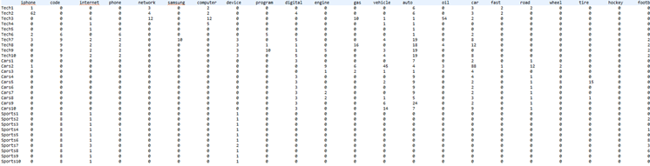
Document Term Matrix
Phase 2
By combining the individual classification totals from the previous slide we create the DTM Document-Term Matrix which displays the feature vectors and all of the word occurrences of these words in the documents of various types

Slide 5

Updating Vectors
Phase 2
We then improved upon our vector lists by looking through our occurrence tables and removing vectors that seemed to be ineffective compared to others. The table on the right depicts the issue of vectors that relate to multiple types. When the term “auto” is used for a car vector we see it’s count is high for not only the car classification but the tech classification as well.
Because of cases like, the final vector list went through multiple revisions to increase its usefulness in our classification and decrease the applicability of vectors to multiple classification types. The final vector list is seen below

Slide 6
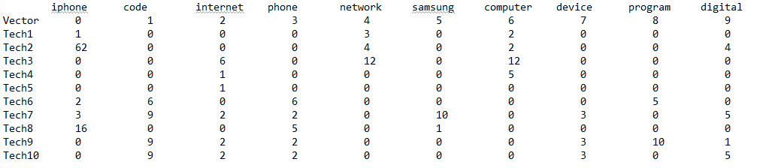
Feature Vectors
Phase 2
Presented below is the selected Tech Vector and its ten defining terms
Tech Vector Group
Part of the DTM, showing the occurrences of each target term in the training tech articles.

Slide 7
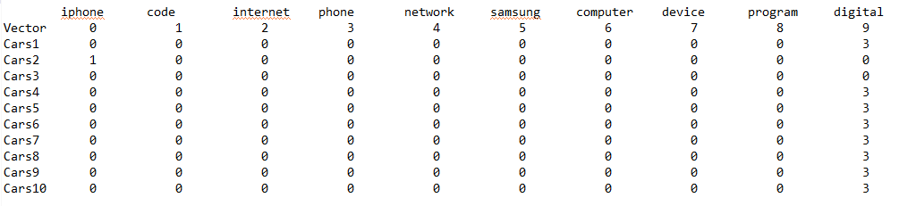
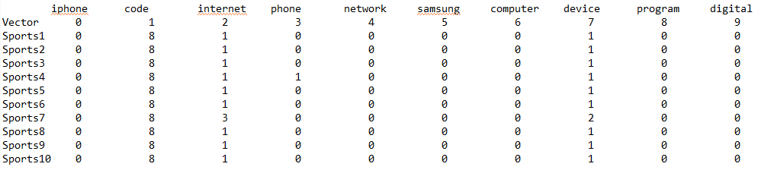
Feature Vectors
Tech Vector Continued...
Data shown for occurrences of target tech vectors in each of the other categories for classification

Slide 8
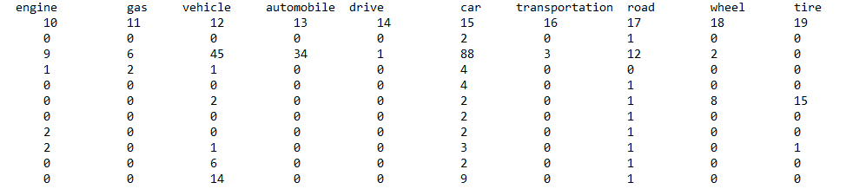

Feature Vectors
Phase 2
Presented below is the selected Car Vector and its ten defining terms
Car Vector Group
Part of the DTM, showing the occurrences of each target term in the training car articles.

Slide 9
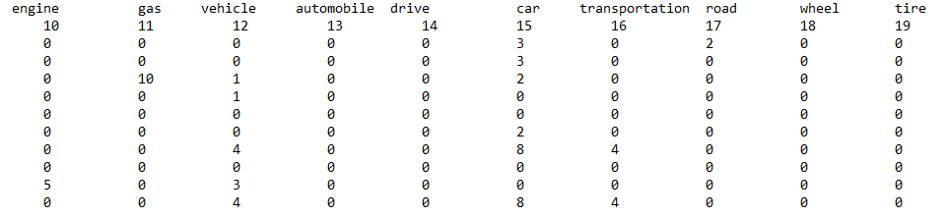

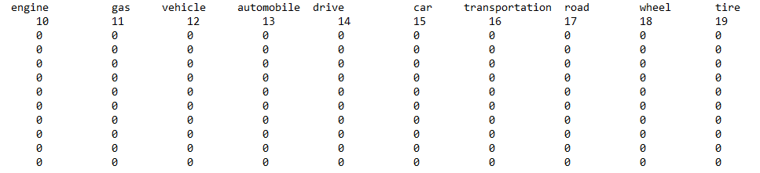

Feature Vectors
Phase 2
Car Vector Continued...
Data shown for occurrences of target car terms in each of the other categories for classification

Slide 10
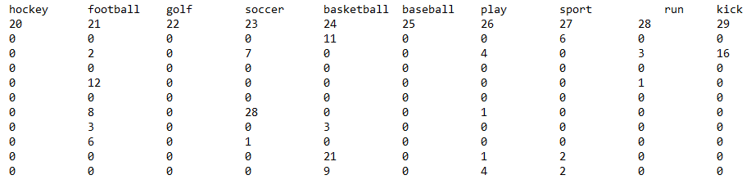
Feature Vectors
Phase 2
Presented below is the selected Sports Vector and its ten defining terms
Sports Vector Group
Part of the DTM, showing the occurrences of each target term in the training sports articles.

Slide 11
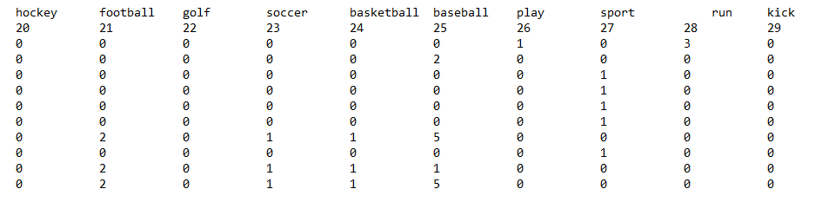
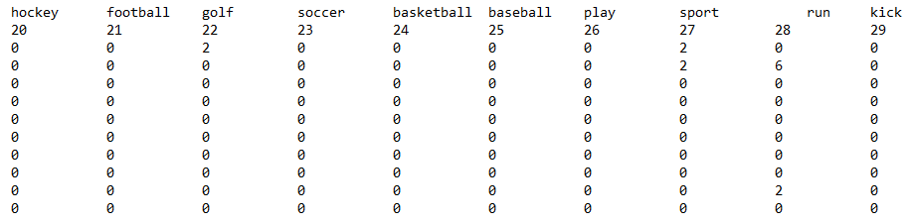
Feature Vectors
Phase 2
Sports Vector Continued...
Data shown for occurrences of target sports terms in each of the other categories for classification

Slide 12
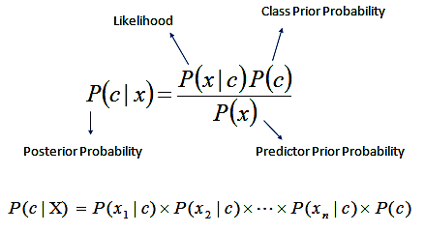
Data Classification
Phase 3
Using Naive Bayes Classification Method
In order to get the variables required for this calculation we must first assemble the data from our training set in a suitable manner

Slide 13
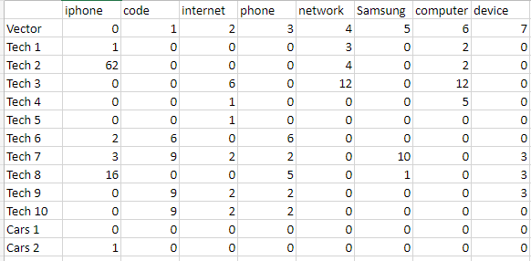
Data Classification
Phase 3
Shown below is a snippet of the DTM.
The entire DTM can be found in the appendix spreadsheet

Slide 14
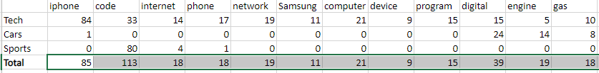
Data Classification
Phase 3
From the DTM we can apply the Naive Bayes Classifier method to the extracted data
(Below a subset of the data is shown, however some columns are left out due to space constraints, the data in its entirety is located in the appendix spreadsheet)
These results are used to learn Class prior probability, likelihood and predictor probabilities which will later be used to classify additional articles.

Slide 15

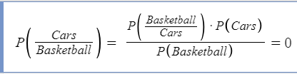

Data Classification
Phase 3
Classifying a new Article
The first step in classifying a new article is to calculate the posterior probability for each class
Note that basketball was the only target term that the article contained

Slide 16

Data Classification
Phase 3
Unknown 1 Classification
Using a new selected article of unknown topic we arrive at the following equation...
As basketball is the only term to appear in the article, and in the training set every mention of basketball was a sports article we end up with a probability score of 1. Looking back at the scores we see this matches our training estimate classifying the article a Sport.

Slide 17
Project Contributions
Adam J
170801790
Data classification and Tech feature vector
Document collection
Naive bayes calculation and classification
Formatting for unknown test articles
Document collection
Deepinder S
170274550
Shane R
170696320
Web Crawler Code
Slide creation
Document collection
Document collection
Abraham B
150411560

Slide 18
Conclusion
Overall, we found that our experiment was accurate.
There was little overlap between the 3 vectors which allowed for accurate results when using the naive bayes theorem to test
All test classifications we did were accurate as shown in the example shared by adam.

